Slide 1

Department of ICT
B.E Sem : II (ICT) (MU)
Subject Name: MAVC
Unit no:- 2
Unit title:
Matrix Algebra I
Subject name : MAVC
Code:01MA1151
Instructor:
Prof. Foram

Slide 2
Introduction
In this chapter ,we will study
Rank and nullity of a matrix
Determination of rank by row operation
Triangularization of matrices by Gauss-elimination process
Computing inverse of a matrix by Row operations
Consistency of system of linear equations.

Slide 3
Matrix
A matrix is simply a rectangular array of numbers.
Matrices are used to organize information into categories that correspond to the rows and columns of the matrix.
An m x n matrix is a rectangular array of numbers with m rows and n columns

Slide 4
Matrix
Elementary row operations:
Add a multiple of one row to another.
Multiply a row by a nonzero constant.
Interchange two rows
We say the matrix has dimension m x n.
The numbers a_{ij} are the entries of the matrix.

Slide 5
Matrix
Symbol | Description
R_{ij} | Interchange the ith and jth rows.
kR_{i} | Multiplication of the ith row by a nonzero number k.
R_{i} + kR_{j} | Addition of k times the j^{th} row to the ith row

Slide 6
Row Echelon Form
A matrix is in echelon form (or row echelon form) if it has the following three properties:
The first non zero number from the left of a non zero row is a 1. This is called a leading 1.
All the entries below leading 1 are 0.
For each non zero row, the leading 1 appears to the right and below any leading 1 in the preceding rows.
Every Zero Row of the matrix A occurs below non zero rows.
Example:

Slide 7

Row Echelon Form
Example 1 Find the Row echelon form of the following matrix
$$\left[\begin{matrix}0 & −1 & 2 & 3 \\ 2 & 3 & 4 & 5 \\ 1 & 3 & −1 & 2 \\ 3 & 2 & 4 & 1\end{matrix}\right]$$

Slide 8
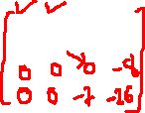



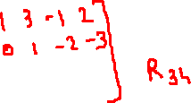


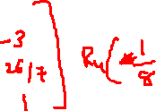





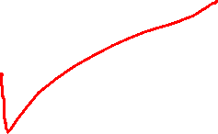
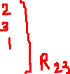
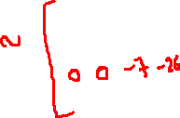



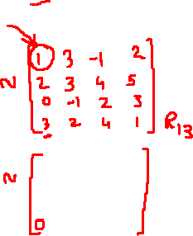

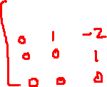

Row Echelon Form
Example 1 Find the Row echelon form of the following matrix
$$\left[\begin{matrix}0 & −1 & 2 & 3 \\ 2 & 3 & 4 & 5 \\ 1 & 3 & −1 & 2 \\ 3 & 2 & 4 & 1\end{matrix}\right]$$

Slide 9

Row Echelon Form
Example 2 Find the Row echelon form of the following matrix
$$\left[\begin{matrix}1 & 2 & −3 & 1 \\ −1 & 0 & 3 & 4 \\ 0 & 1 & 2 & −1 \\ 2 & 3 & 0 & −3\end{matrix}\right]$$

Slide 10
Reduced Row Echelon Form
If a matrix in echelon form satisfies the following additional condition, then it is in Reduced Row Echelon Form.
4. Each leading 1 is the only nonzero entry in its column.
Note: The Reduced Row Echelon form of a matrix is always unique.

Slide 11
Process to get the Reduced Row Echelon Form
Use the elementary row operations to put the matrix in row-echelon form.
Obtain zeros above each leading entry by adding multiples of the row containing that entry to the rows above it.

Slide 12
Reduced Row Echelon Form
Matrix in Reduced Row Echelon form

Slide 13

Reduced Row Echelon Form
Example 3 Find the Reduced Row echelon form of the following matrix
$$\left[\begin{matrix}0 & −1 & 2 & 3 \\ 2 & 3 & 4 & 5 \\ 1 & 3 & −1 & 2 \\ 3 & 2 & 4 & 1\end{matrix}\right]$$

Slide 14
Reduced Row Echelon Form
Example 3 Find the Reduced Row echelon form of the following matrix
$$\left[\begin{matrix}0 & −1 & 2 & 3 \\ 2 & 3 & 4 & 5 \\ 1 & 3 & −1 & 2 \\ 3 & 2 & 4 & 1\end{matrix}\right]$$

Slide 16

Reduced Row Echelon Form
Find the Row Echelon and Reduced Row echelon form of the following matrix
$$\left[\begin{matrix}1 & 2 & −3 & 1 \\ 0 & 0 & 3 & 4 \\ 0 & 1 & 2 & −1 \\ 2 & 3 & 0 & −3\end{matrix}\right]$$

Slide 17

Reduced Row Echelon Form
Find the Reduced Row echelon form of the following matrix
$$\left[\begin{matrix}1 & 2 & −3 & 1 \\ 0 & 1 & 2 & −1 \\ 1 & 2 & 1 & 3 \\ 5 & 1 & −1 & 1\end{matrix}\right]$$

Slide 18
Rank of a Matrix
The rank of this matrix is 4.
Rank of a Matrix by Row Echelon Form
The rank of a matrix in row echelon form is equal to the number of non zero rows of the matrix

Slide 19

Rank of a Matrix
Find the Rank using Row echelon form of the following matrix
$$\left[\begin{matrix}5 & 3 & 14 & 4 \\ 0 & 1 & 2 & 1 \\ 1 & −1 & 2 & 0\end{matrix}\right]$$

Slide 20

Rank of a Matrix
Find the Rank using Row echelon form of the following matrix
$$\left[\begin{matrix}1 & 2 & 3 & −1 \\ −2 & −1 & −3 & −1 \\ 1 & 0 & 1 & 1 \\ 0 & 1 & 1 & −1\end{matrix}\right]$$

Slide 21

Rank of a Matrix
Rank of a Matrix by Determinant Method
The rank of a matrix is less than or equal to r, if all (r+1) rowed minor of the matrix are zero.
The rank of a matrix is greater than or equal to r, if at least one minor of the matrix is not equal to zero.
The rank of a null matrix is zero.
The rank of a non singular square matrix is always equal to its order.
The following matrix has rank = 2
$$\left[\begin{matrix}1 & 2 & 3 \\ 3 & 4 & 5 \\ 4 & 5 & 6\end{matrix}\right]$$

Slide 22

Rank of a Matrix
Example 9 Find the Rank using Determinant Method of the following matrix
$$\left[\begin{matrix}2 & 3 & 4 \\ 4 & 3 & 1 \\ 1 & 2 & 4\end{matrix}\right]$$

Slide 23

Rank of a Matrix
Example 10 Find the Rank using Determinant Method of the following matrix
$$\left[\begin{matrix}1 & 2 & 3 \\ 3 & 4 & 5 \\ 4 & 5 & 7\end{matrix}\right]$$

Slide 24

Rank of a Matrix
Example 11 Find the Rank using Determinant Method of the following matrix
$$\left[\begin{matrix}1 & 2 & −1 & 4 \\ 2 & 4 & 3 & 5 \\ −1 & −2 & 6 & −7\end{matrix}\right]$$

Slide 25

Rank of a Matrix
Example 12 Find the value of p for which the rank of the following matrix A will be of
i) rank one ii) rank two iii) rank three
$$\left[\begin{matrix}3 & p & p \\ p & 3 & p \\ p & p & 3\end{matrix}\right]$$

Slide 26
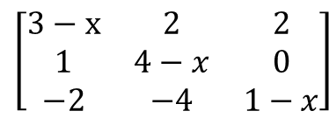
Rank of a Matrix
Example 13 Find the value of x for which the rank of the following matrix A will be of
i) equal to 3 ii) less than 3
$$\left[\begin{matrix}3−x & 2 & 2 \\ 1 & 4−x & 0 \\ −2 & −4 & 1−x\end{matrix}\right]$$

Slide 27
Nullity
The rank of A equals the number of nonzero rows in the row echelon form, which equals the number of leading entries. The nullity of A equals the number of free variables in the corresponding system, which equals the number of columns without leading entries
(No. of columns – rank =nullity)

Slide 28
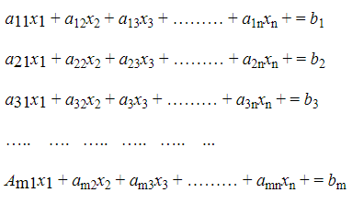
System of Linear Equations
System of Linear Equations in Matrix Form
A system of m linear equations in n unknowns is of the following form:
where the coefficients a_{ij} , i = 1, 2, …. , m; j = 1, 2,….., n and b_{k} , k = 1, 2,….., m are constants. If all the b_{k} 's are zeros, then the above system is called a homogeneous system of linear equations. On the other hand, if at least one of the b_{k} 's is non-zero, then the above system is called a non-homogeneous system of linear equations. If there exist values α₁ , α₂ , ….. , α_{n} for x₁, x₂ , …. , x_{n} respectively which satisfy every equation of (1), then the ordered n − tuple (α₁ , α₂ , …. , α_{n} ) is called a solution of (1).

Slide 29
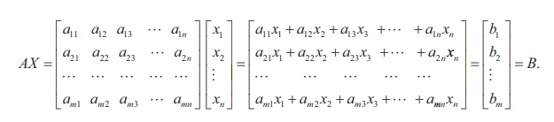
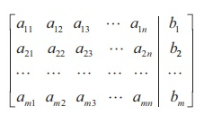
System of Linear Equations
AX = B is a matrix equation involving matrices and it is called the matrix form of the system of linear equations (1). The matrix A is called the coefficient matrix of the system and the matrix
is called the augmented matrix of the system. We denote the augmented matrix by [ A | B ].

Slide 30
System of Linear Equations
The Augmented Matrix of a Linear System
Linear System | Augmented Matrix
Notice that a missing variable in an equation corresponds to a 0 entry in the augmented matrix.

Slide 31
System of Linear Equations
Gaussian Elimination
To solve a system of linear equations using its augmented matrix, we use elementary row operations to arrive at a matrix in row echelon form.
Once an augmented matrix is in row-echelon form, we can solve the corresponding linear system using back-substitution.
Solve the system of linear equations.

Slide 32
System of Linear Equations
Gaussian Elimination
System | Augmented Matrix

Slide 33
System of Linear Equations

Slide 34
System of Linear Equations
Now, we use back-substitution to find that: x = 2, y = 7, z = 3
The solution is (2, 7, 3).

Slide 35
System of Linear Equations
Example 14 Solve the system of linear system by Gaussian elimination method
x + y + 2z = 9
2x + 4y - 3z = 1
3x + 6y - 5z = 0
Answer x=1, y=2, z=3

Slide 36
System of Linear Equations
Example 15 Solve the system of linear system by Gaussian elimination method
4x - 2y + 6z = 8
x + y - 3z = -1
15x - 3y + 9z = 21
Answer x=1, y=3t-2, z=t

Slide 37
System of Linear Equations
Example 16 Solve the system of linear system by Gaussian elimination method
3x + y - 3z = 13
2x - 3y + 7z = 5
2x + 19y - 47z = 32
Answer No sol

Slide 38
System of Linear Equations
Example 17 Investigate for what values of λ and μ the equations have (i) No solution (ii) a unique solution and (iii) many solutions
x + 2y + z = 8
2x + 2y + 2z = 13
3x + 4y + λz = μ

Slide 39
System of Linear Equations

Slide 40
System of Linear Equations
Gauss Jordan Elimination
To solve a system of linear equations using its augmented matrix, we use elementary row operations to arrive at a matrix in reduced row echelon form.
Once an augmented matrix is in reduced row-echelon form, we can solve the corresponding linear system using back-substitution

Slide 41
System of Linear Equations
Example 18 Solve the system of linear system by Gauss Jordan elimination method
x + y + 2z = 8
-x + 2y + 3z = 1
3x - 7y + 4z = 10
Answer x=3 y=1 z=2

Slide 42
System of Linear Equations
Example 19 Solve the system of linear system by Gauss Jordan elimination method
a - 2b - c + 3d = 1
2a – 4b + c = 5
a - 2b + 2c – 3d = 4
Answer a=2+2t1-t2, b=t1, c=1+2t2, d=t2

Slide 43
System of Linear Equations
Example 20 Solve the system of linear system by Gauss Jordan elimination method
2x - y + 2z = 9
3x - y + z = 6
4x - y + 2z = 7
-x + y – z = 4
Answer no solution

Slide 44
System of Homogeneous Linear Equations

Slide 45
System of Linear Equations
Example 21 Solve the system of linear system by Gauss Jordan elimination method
x + y - z + w = 0
x – y + 2z – w = 0
3x + y + w = 0
Answer x=-1/2t1, y=3/2t1, z=t1, w=t2
(Non Trivial)

Slide 46
System of Linear Equations
Example 20 Solve the system of linear system by Gauss Jordan elimination method
2x + y + 3z = 0
x + 2y = 0
y + z = 0

Slide 47

Inverse of a Matrix
We have seen above that when A is multiplied with its inverse, it would result to an identity matrix I (bunch of 1s on the main diagonal of the matrix and surrounded with 0s). Mathematically,
If we exchange the position of A and its inverse,
If we think harder, it’s like solving for X. From AX = B, A is still A but B is now I. Instead of getting X, we are now solving for A^{-1}. What we did earlier was we augment A and B, and use Gauss-Jordan elimination to get X. That’s what we’re also going to do here, we put A and I together and row-reduced it to get the inverse of A.

Slide 48
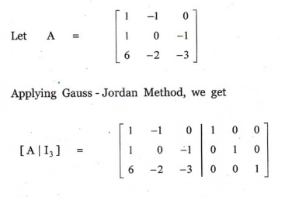
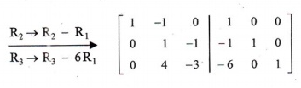

Inverse of a Matrix

Slide 49
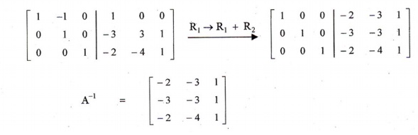
Inverse of a Matrix

Slide 50
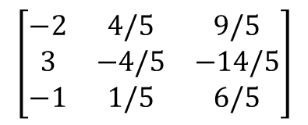
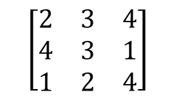
Inverse of a Matrix
Example 21 Find the inverse of the following matrix using Gauss Jordan Elimination
Answer
$$\left[\begin{matrix}2 & 3 & 4 \\ 4 & 3 & 1 \\ 1 & 2 & 4\end{matrix}\right]$$
$$\left[\begin{matrix}−2 & 4/5 & 9/5 \\ 3 & −4/5 & −14/5 \\ −1 & 1/5 & 6/5\end{matrix}\right]$$

Slide 51
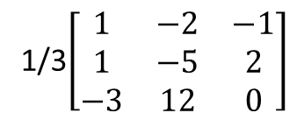
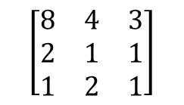
Inverse of a Matrix
Example 22 Find the inverse of the following matrix using Gauss Jordan Elimination
Answer
$$\left[\begin{matrix}8 & 4 & 3 \\ 2 & 1 & 1 \\ 1 & 2 & 1\end{matrix}\right]$$
1/3$\left[\begin{matrix}1 & −2 & −1 \\ 1 & −5 & 2 \\ −3 & 12 & 0\end{matrix}\right]$

Slide 52
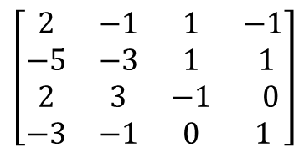
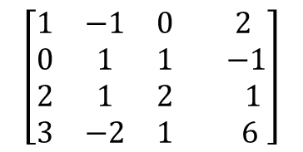
Inverse of a Matrix
Example 23 Find the inverse of the following matrix using Gauss Jordan Elimination
Answer
$$\left[\begin{matrix}2 & −1 & 1 & −1 \\ −5 & −3 & 1 & 1 \\ 2 & 3 & −1 & 0 \\ −3 & −1 & 0 & 1\end{matrix}\right]$$
$$\left[\begin{matrix}1 & −1 & 0 & 2 \\ 0 & 1 & 1 & −1 \\ 2 & 1 & 2 & 1 \\ 3 & −2 & 1 & 6\end{matrix}\right]$$

Slide 53
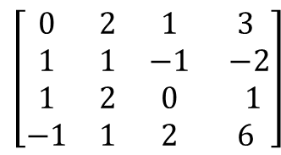
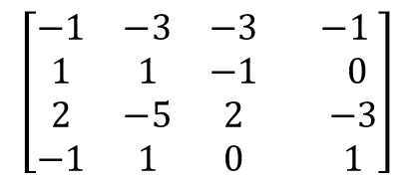
Inverse of a Matrix
Example 24 Find the matrix A if A inverse is the following matrix
Answer
$$\left[\begin{matrix}0 & 2 & 1 & 3 \\ 1 & 1 & −1 & −2 \\ 1 & 2 & 0 & 1 \\ −1 & 1 & 2 & 6\end{matrix}\right]$$
$$\left[\begin{matrix}−1 & −3 & −3 & −1 \\ 1 & 1 & −1 & 0 \\ 2 & −5 & 2 & −3 \\ −1 & 1 & 0 & 1\end{matrix}\right]$$

Slide 54
Consistency : System of Linear Equations
If a linear system is consistent, then the solution set contains either
(i) a unique solution, when there are no free variables
(ii) infinitely many solutions, when there is at least one free variable.
If a linear system is inconsistent, then the system has no solution

Slide 55
Given the linear system Ax = B and the augmented matrix (A|B).
1) If rank(A) = rank(A|B) = the number of rows in x, then the system has a unique solution.
2) If rank(A) = rank(A|B) < the number of rows in x, then the system has ∞-many solutions.
3) If rank(A) < rank(A|B), then the system is inconsistent.

Slide 56
THANK YOU

